Slide 1
MACHINE LEARNING PROJECT EVALUATION
SUBMITTED BY: -
Shoumik Bhattacharya (MT21144)
Spandan Ghosh (MT21095)
Arghya Mukherjee (MT21014)

Slide 2
HANDWRITTEN DIGIT RECOGNITION
Problem Statement and Objective:-
Handwritten digit recognition is the ability of computer systems to recognize various handwritten digits from their images.
Our purpose is to write a computer program that takes the image of a handwritten digit as input, and then identify the digit in that image.
Problem type - Classification
Image of a Handwritten Digit
ML Model
Recognized Digit

Slide 3
DATASET USED
We will be using the MNIST Dataset containing 70,000 handwritten digits which are divided into 60,000 Training examples and 10,000 Test Examples.
The dataset contains images, in the form of an array having (28 x 28) values representing that image along with their labels. These values are pixel values ranging from 0 (Black) to 255 (White).
The labels values are from 0 to 9.
The data is stored in 4 files: -
train-images-idx3-ubyte : training set images
train-labels-idx1-ubyte : training set labels
t10k-images-idx3-ubyte : test set images
t10k-labels-idx1-ubyte : test set labels
Link for the dataset: - http://yann.lecun.com/exdb/mnist/

Slide 4
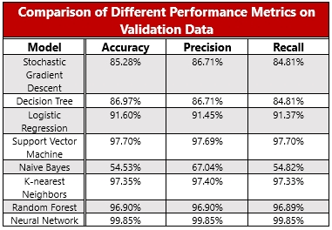
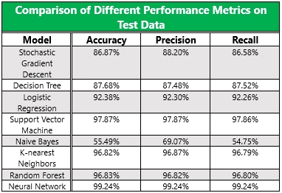
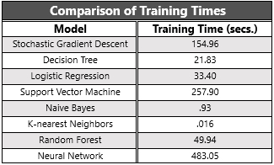
Comparison of performance metrics

Slide 5
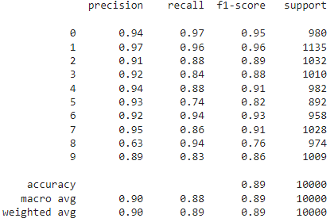
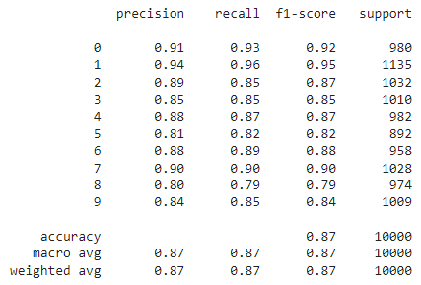
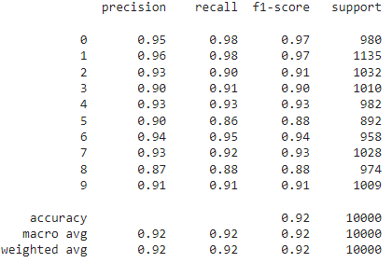
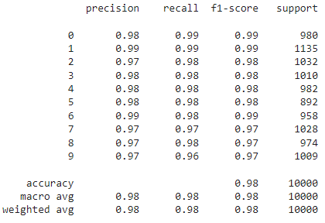
Classification Report
Stochastic GD
Decision Tree
Logistic Regression
Support Vector Machine

Slide 6
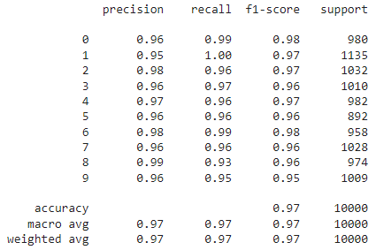

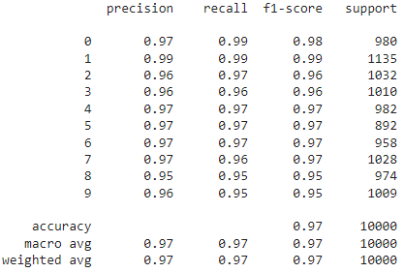

Classification Report
K- Nearest Neighbor
Naïve Bayes
Random Forest
CNN

Slide 7
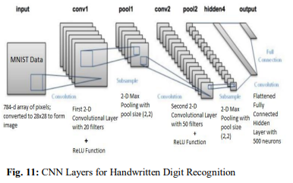
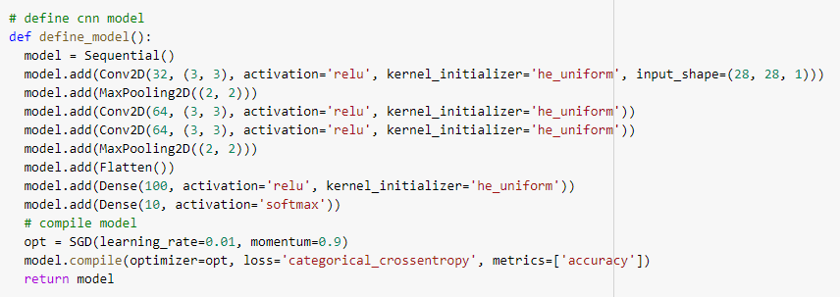
CNN Architecture
A sample CNN for Digit Recognition
CNN used by us

Slide 8
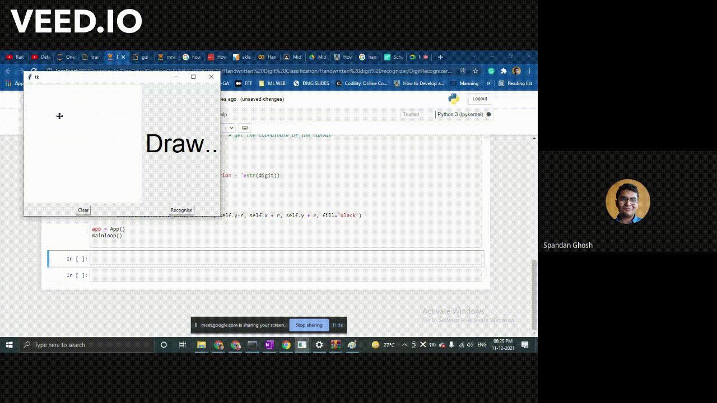
Predictions made by the best model

